Slide 1


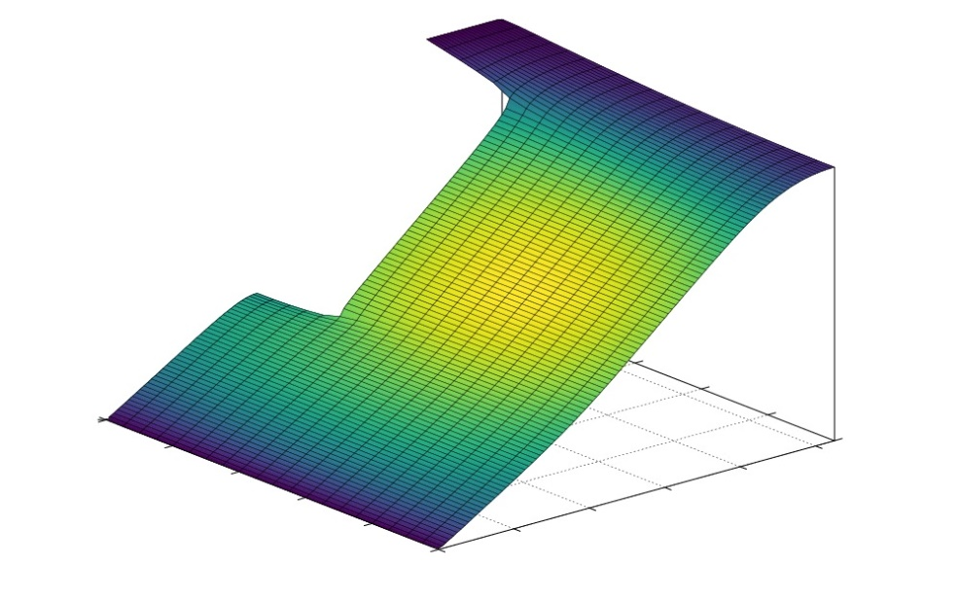
Case Study in Scientific Computing
By Brady, Georgia and Markus

Slide 2
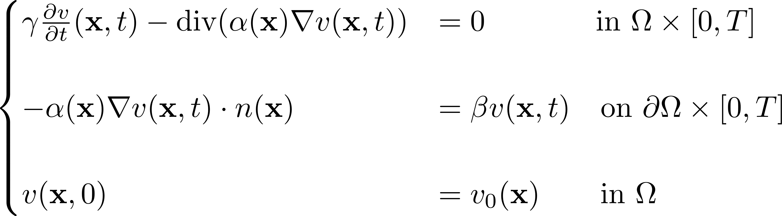
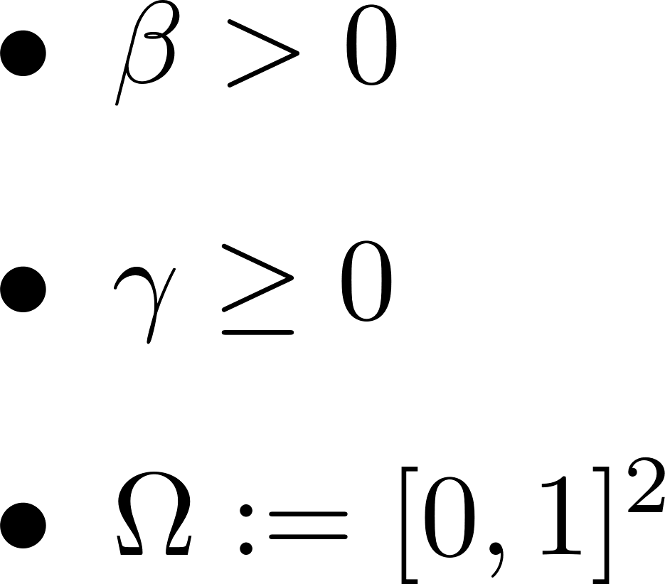
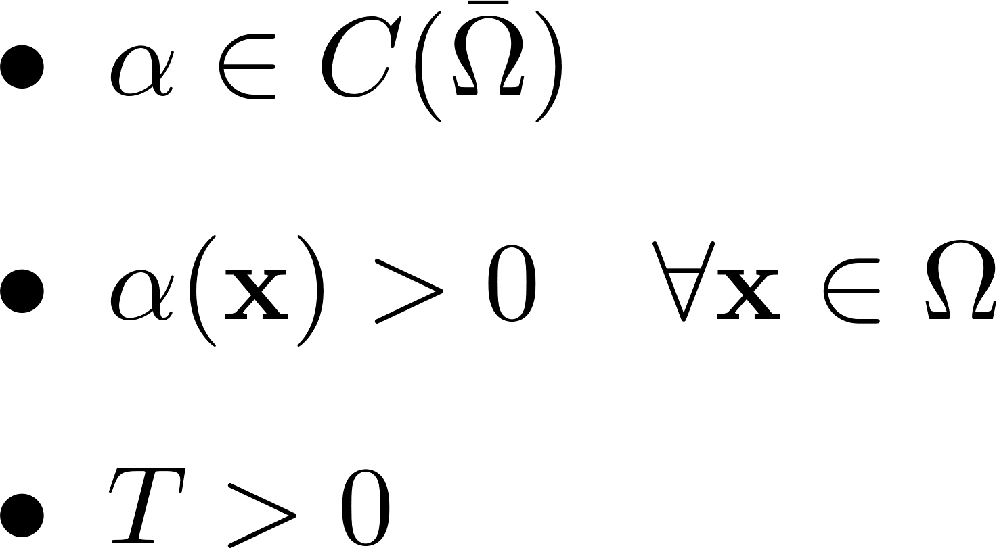
Problem 1
University of Oxford
Mathematical Institute
EPSRC Centre for Doctoral Training in Industrially Focused Mathematical Modelling

Slide 3





Numerical Method for Problem 1
University of Oxford
Mathematical Institute
EPSRC Centre for Doctoral Training in Industrially Focused Mathematical Modelling

Slide 4
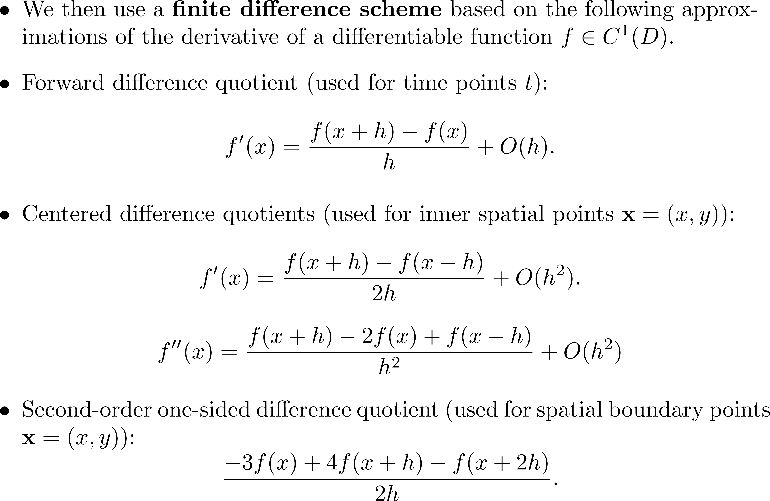
Numerical Method for Problem 1
University of Oxford
Mathematical Institute
EPSRC Centre for Doctoral Training in Industrially Focused Mathematical Modelling

Slide 5
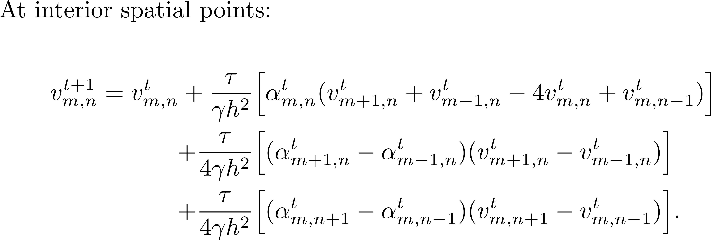
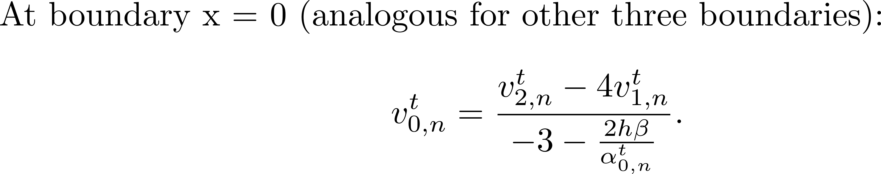
Derived Finite Difference Scheme
University of Oxford
Mathematical Institute
EPSRC Centre for Doctoral Training in Industrially Focused Mathematical Modelling

Slide 6
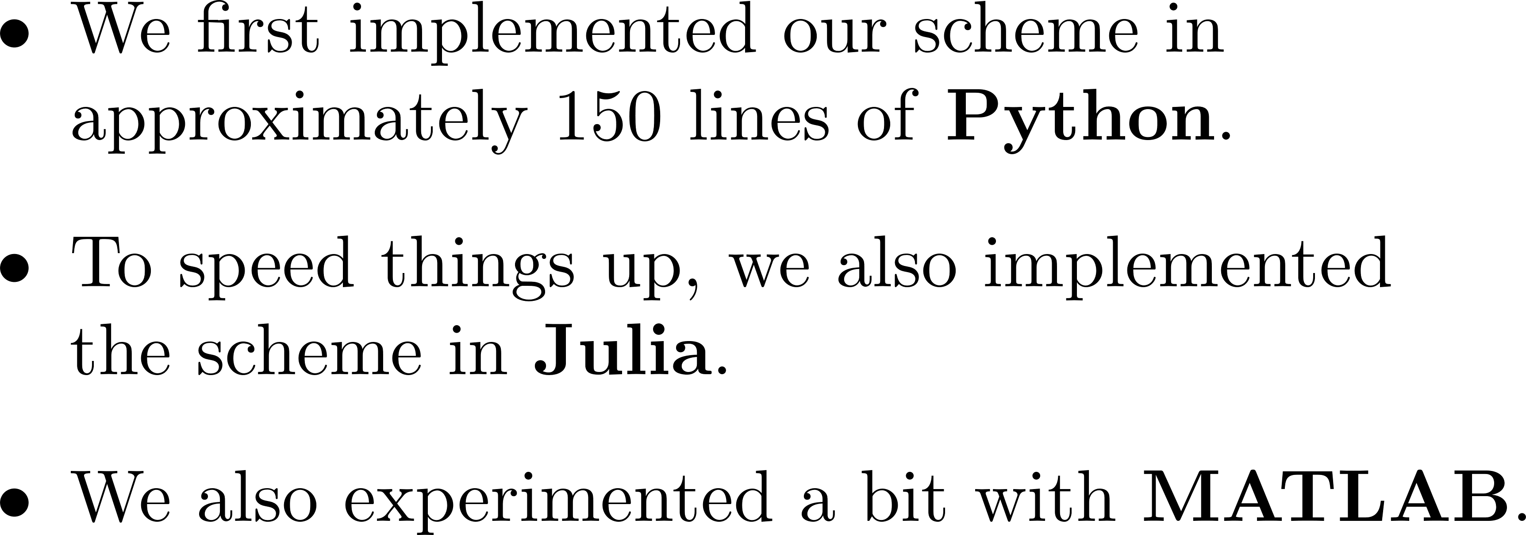
Implementation
University of Oxford
Mathematical Institute
EPSRC Centre for Doctoral Training in Industrially Focused Mathematical Modelling

Slide 7
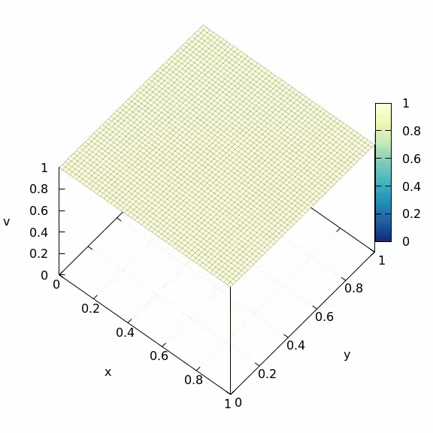
Visualisation of Results
University of Oxford
Mathematical Institute
EPSRC Centre for Doctoral Training in Industrially Focused Mathematical Modelling

Slide 8
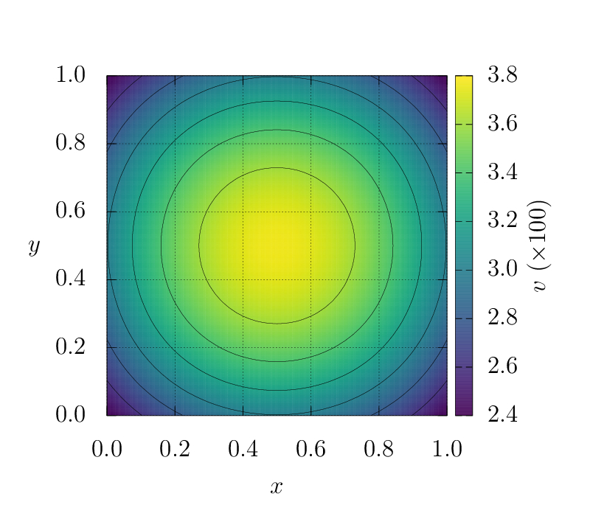

Visualisation of Results
University of Oxford
Mathematical Institute
EPSRC Centre for Doctoral Training in Industrially Focused Mathematical Modelling

Slide 9
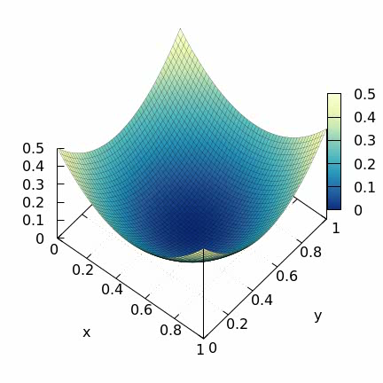
Visualisation of Results
University of Oxford
Mathematical Institute
EPSRC Centre for Doctoral Training in Industrially Focused Mathematical Modelling

Slide 10
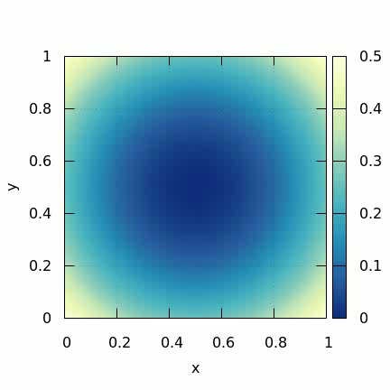
Visualisation of Results
University of Oxford
Mathematical Institute
EPSRC Centre for Doctoral Training in Industrially Focused Mathematical Modelling

Slide 11
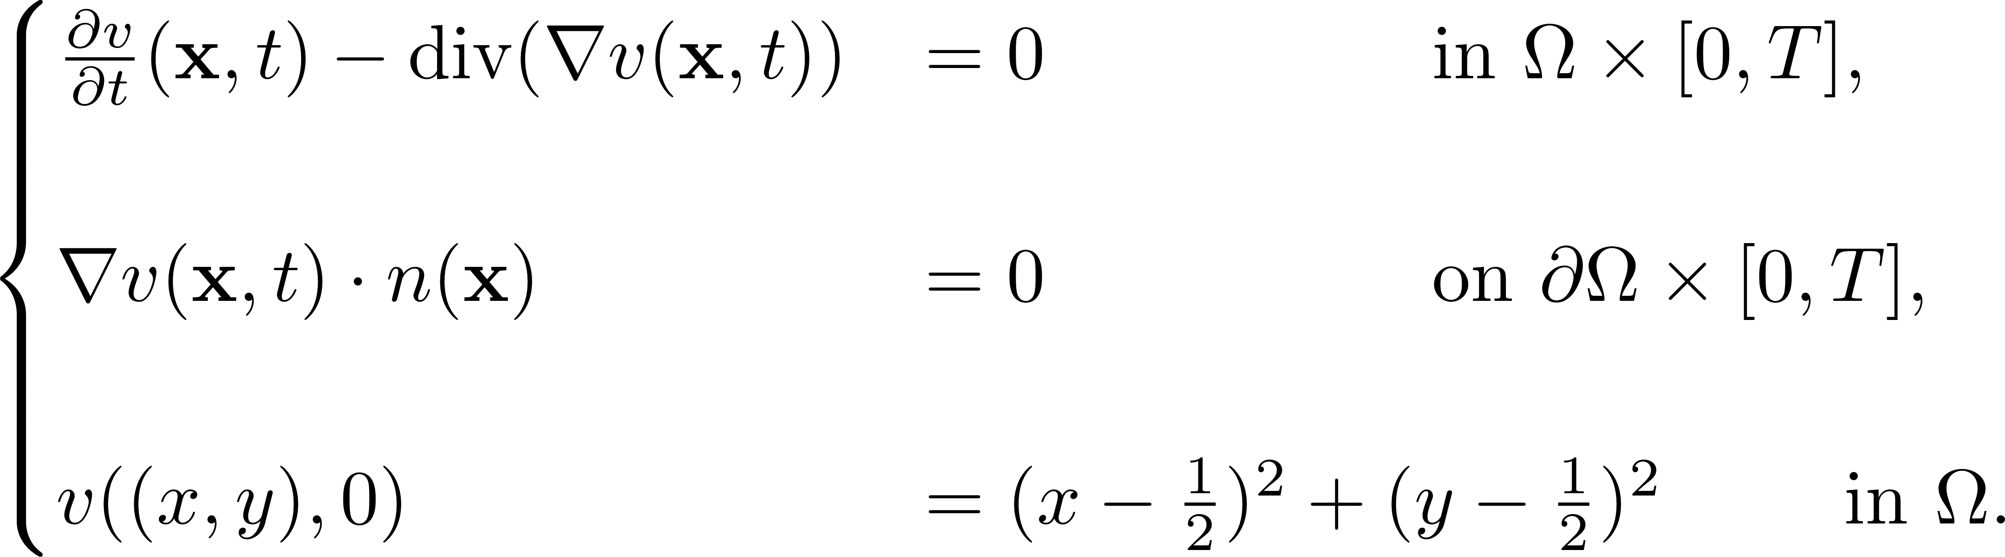
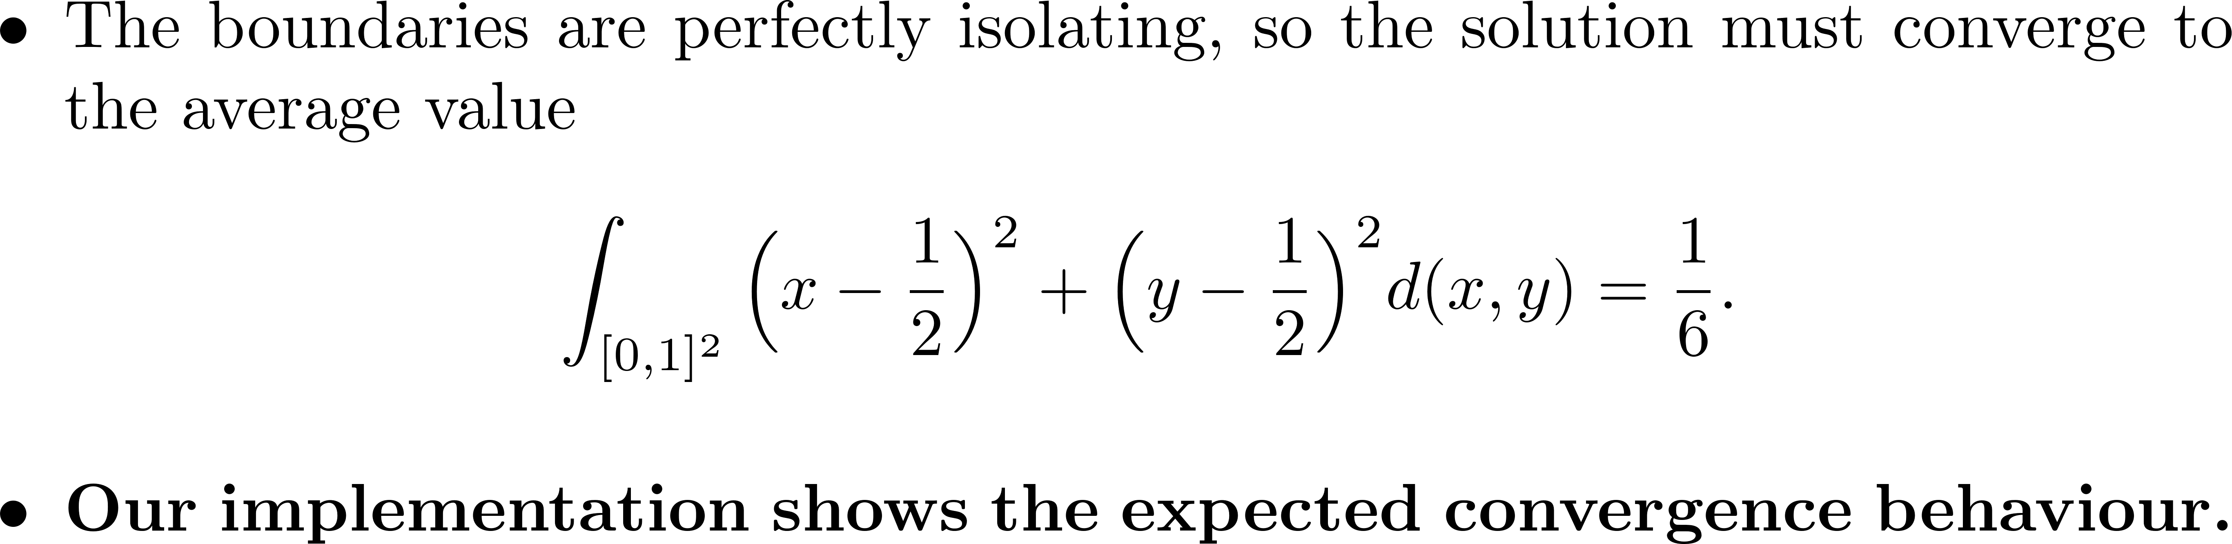
Test to Validate Implementation
University of Oxford
Mathematical Institute
EPSRC Centre for Doctoral Training in Industrially Focused Mathematical Modelling

Slide 12
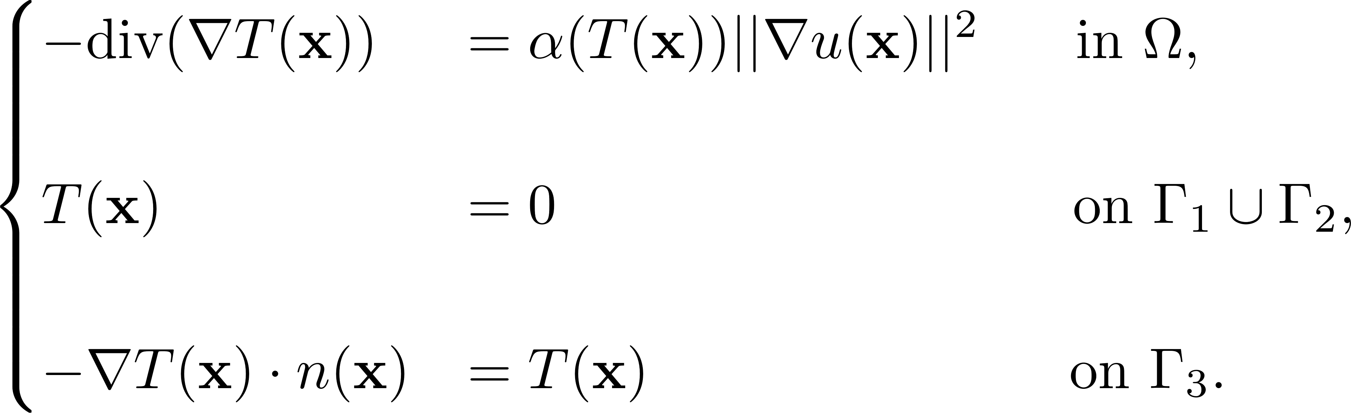
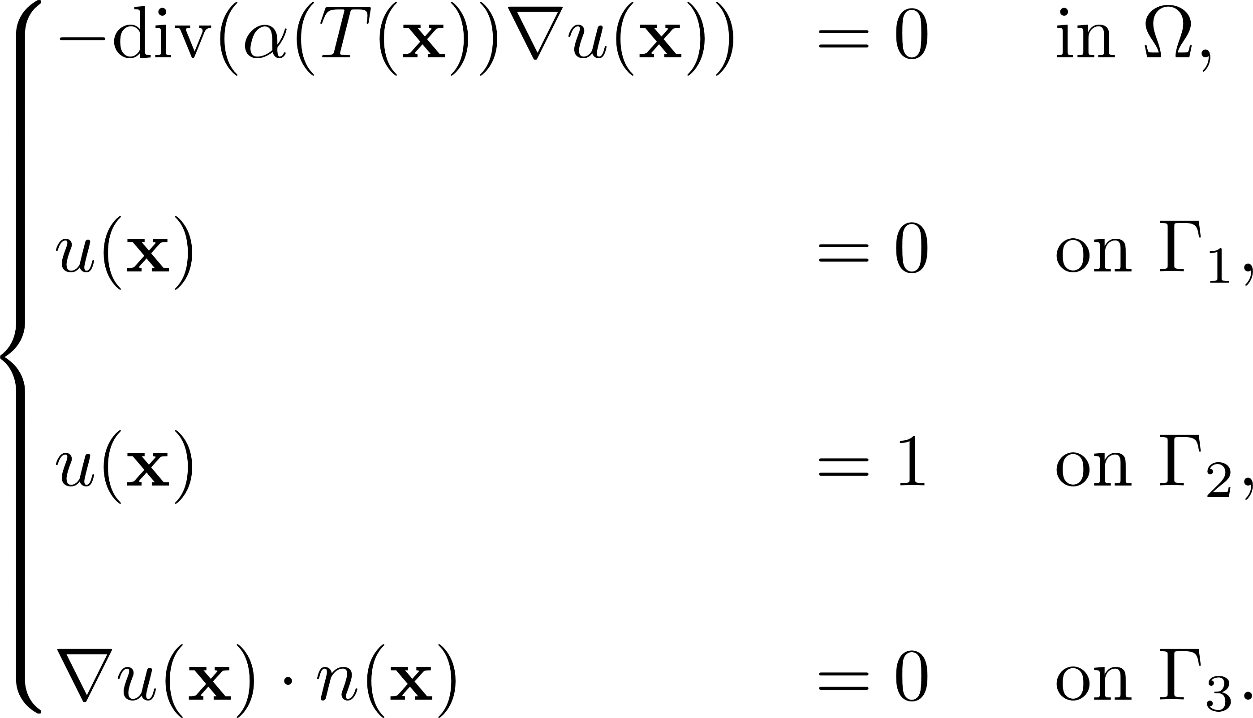
Problem 2
University of Oxford
Mathematical Institute
EPSRC Centre for Doctoral Training in Industrially Focused Mathematical Modelling

Slide 13
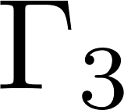



Domain for Problem 2
University of Oxford
Mathematical Institute
EPSRC Centre for Doctoral Training in Industrially Focused Mathematical Modelling

Slide 14
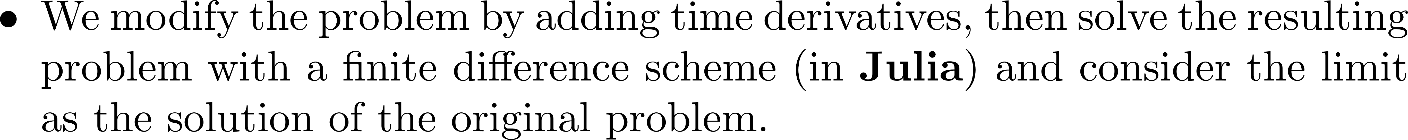
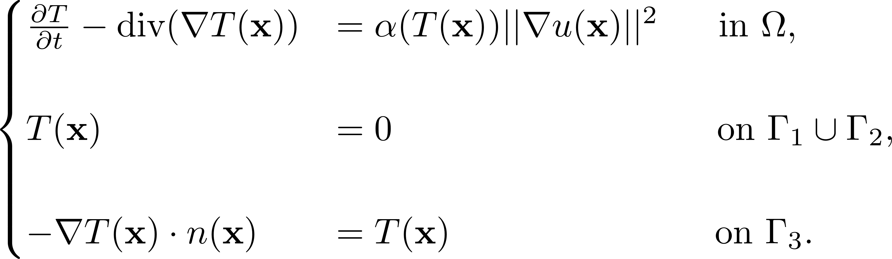
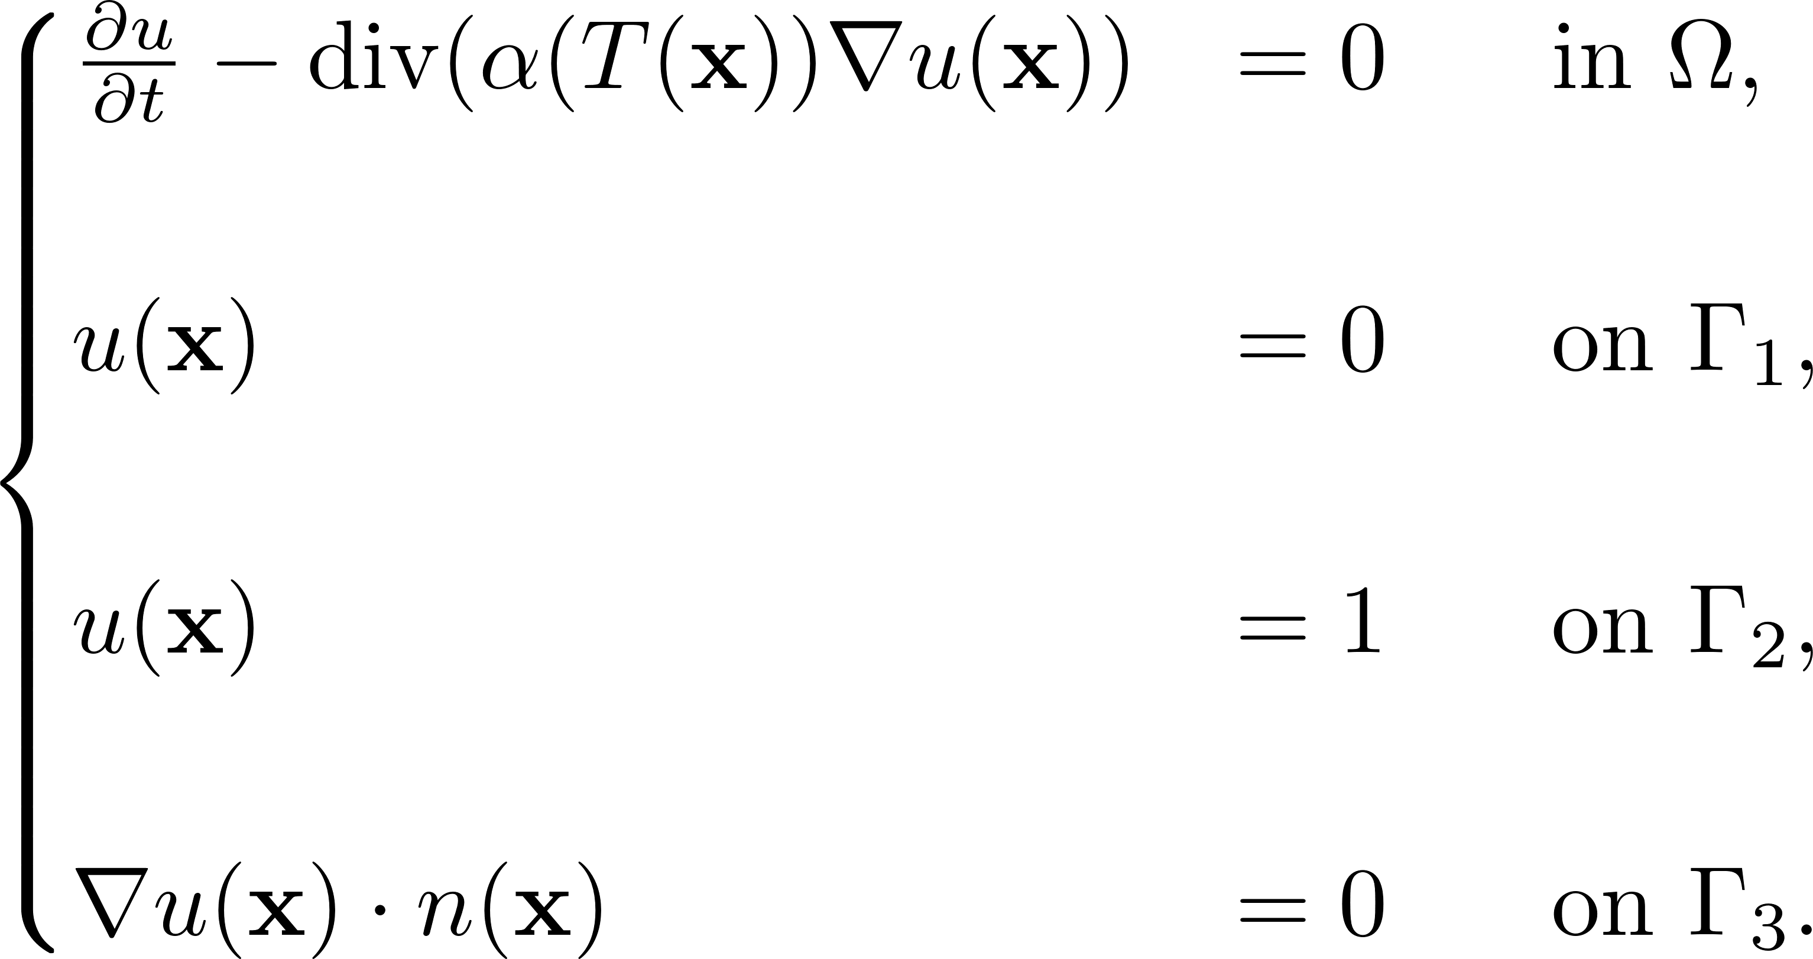
Numerical Solution Strategy
University of Oxford
Mathematical Institute
EPSRC Centre for Doctoral Training in Industrially Focused Mathematical Modelling

Slide 15
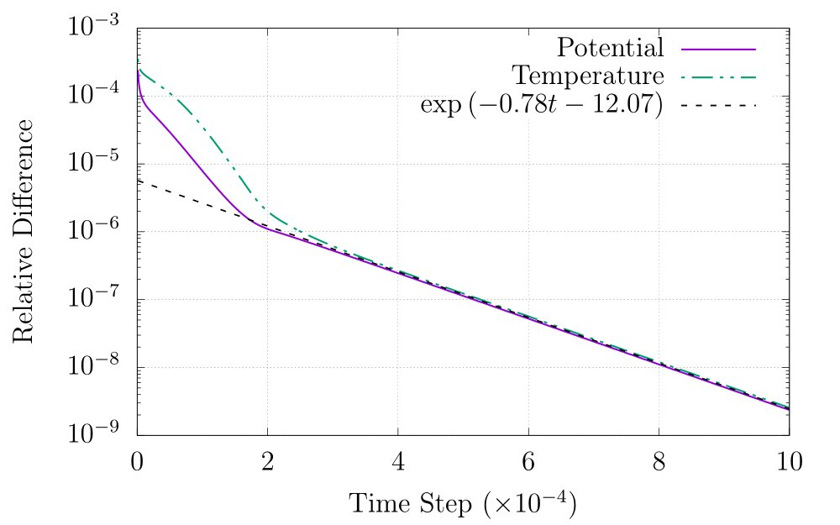
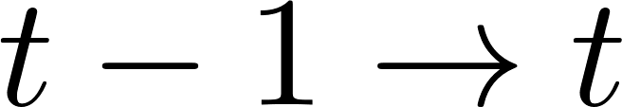
Visualisation of Results
University of Oxford
Mathematical Institute
EPSRC Centre for Doctoral Training in Industrially Focused Mathematical Modelling

Slide 16

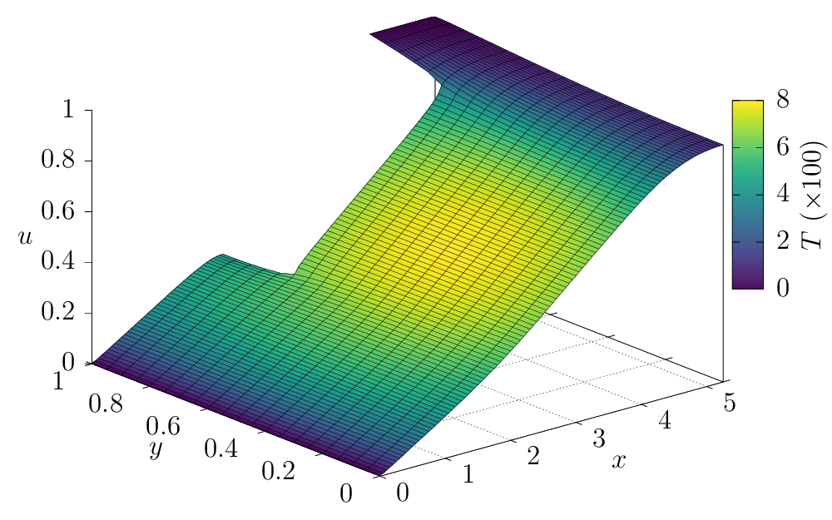
Visualisation of Results
University of Oxford
Mathematical Institute
EPSRC Centre for Doctoral Training in Industrially Focused Mathematical Modelling

